Slide 1
Assessment and Accreditation
Stacy Hutchinson, Ph.D
Biological and Agricultural Engineering
Kansas State University
Manhattan, KS 66502

Slide 2
Assessment
Assessment-
the process of collecting information about student learning and performance to improve education.
The goal of assessment is to improve student learning

Slide 3
Assessment
Where do we want students to be at the end of a course or a program?
And how will we know if they get there?

Slide 4
10 Principles of Meaningful Assessment
1. You have more data than you think you do. Go find it.
2. Assessment should not be redundant. Instruments should be compared to gauge overlap, gaps, and deficits.
3. Big sample sizes don’t equal progress. You need as much evidence as it will take to move the conversation forward.
4. Students should not receive assessment. Assessment should be part of the learning process.
5. If you collect it, you should use it – the good data, the bad data, and the ugly data.
Ashley Finley
Association of American Colleges and Universities
January 2015

Slide 5
10 Principles of Meaningful Assessment
6. What students think isn’t necessarily what they can do. Assessment of student learning should be both indirect and direct.
7. Assessment should reflect, match, and advance the institutional mission.
8. Remember Plato: “Necessity is the mother of invention.” If you need it, create your own assessment.
9. Assessment isn’t just for outcomes. Assessment is for inputs, processes, and outputs too.
10. Assessment is only as good (and as limited) as your assumptions allow it to be.
Ashley Finley
Association of American Colleges and Universities
January 2015

Slide 6
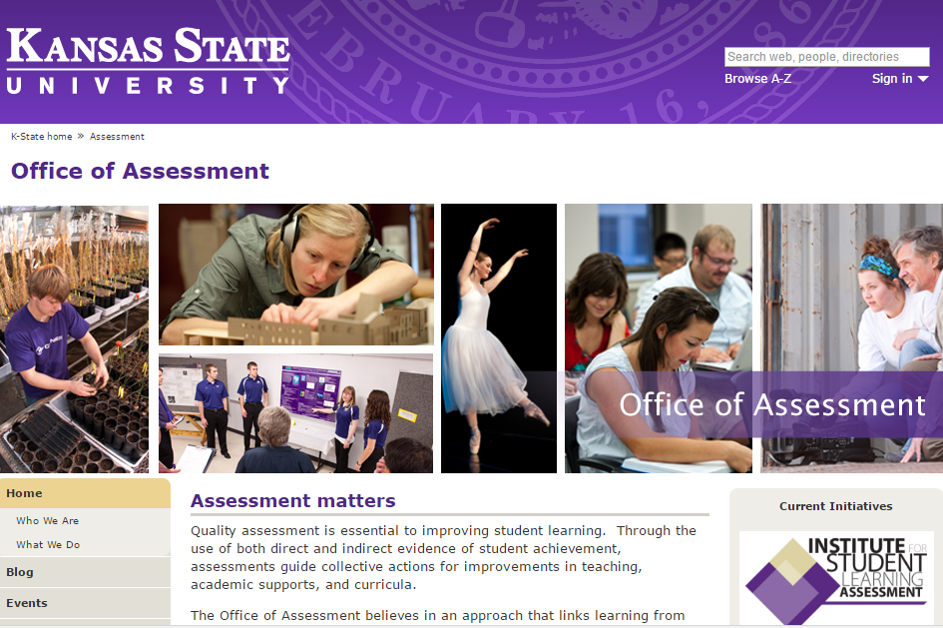
Assessment at Kansas State University
https://www.k-state.edu/assessment/

Slide 7
Student Learning Outcomes
Students Learning Outcomes:
specify what students will know and be able to do as a result of completing their degree programs
State of Kansas

Slide 8
Student Learning Outcomes
Outcomes are specific and measurable and must reflect the curriculum.
Express a benefit or "value added" that a student can demonstrate upon completion of an academic program or course.
Contains all three of the following elements:
what is to be learned (knowledge, skill, attitude),
what level of learning is to be achieved (criteria, standard), and
under what conditions the learning is to be demonstrated (environment, support, etc.)
State of Kansas

Slide 9
University SLOs
Does NMU have University level student learning outcomes?
Department level?

Slide 10
Student Learning Outcomes
Outcomes are specific and measurable and must reflect the curriculum.
Express a benefit or "value added" that a student can demonstrate upon completion of an academic program or course.
Contains all three of the following elements:
what is to be learned (knowledge, skill, attitude),
what level of learning is to be achieved (criteria, standard), and
under what conditions the learning is to be demonstrated (environment, support, etc.)
State of Kansas

Slide 11
University SLOs
Knowledge: Students will demonstrate a depth of knowledge and apply the methods of inquiry in a discipline of their choosing, and they will demonstrate a breadth of knowledge across their choice of varied disciplines.
Critical Thinking: Students will demonstrate the ability to access and interpret information, respond and adapt to changing situations, make complex decisions, solve problems, and evaluate actions.
Communication: Students will demonstrate the ability to communicate clearly and effectively.
Diversity: Students will demonstrate awareness and understanding of the skills necessary to live and work in a diverse world.
Academic and Professional Integrity: Students will demonstrate awareness and understanding of the ethical standards of their academic discipline and/or profession.
State of Kansas

Slide 12
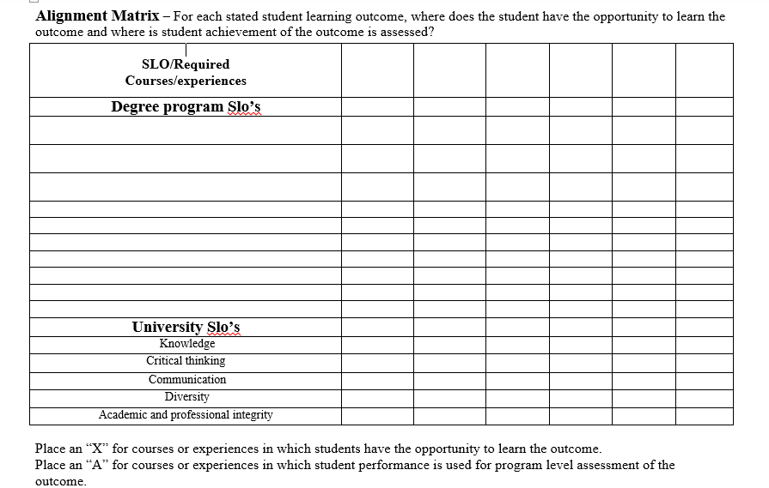
Assessment

Slide 13
Assessment <-> Accreditation
Connecting student learning to industry

Slide 14
Accreditation
Accreditation Board for Engineering and Technology:
a nonprofit, non-governmental organization recognized by the Council for Higher Education Accreditation (CHEA).
accredits college and university programs in the disciplines of applied science, computing, engineering, and engineering technology at the associate, bachelor, and master degree levels.
30 Countries– Austria, Kazakhstan, Russia, Spain, Turkey

Slide 15
Accreditation
Engineering programs are accredited on a 6 year cycle.
Engineers must graduate from an ABET accredited program in order to qualify for licensure in U.S.
Different engineering degree programs are governed by their respective professional societies

Slide 16
Accreditation
GENERAL CRITERIA FOR BACCALAUREATE LEVEL PROGRAMS
Criterion 1. Students
Criterion 2. Program Educational Objectives
Criterion 3. Student Outcomes
Criterion 4. Continuous Improvement
Criterion 5. Curriculum
Criterion 6. Faculty
Criterion 7. Facilities
Criterion 8. Institutional Support

Slide 17
Program Educational Objectives
GENERAL CRITERION 2. PROGRAM EDUCATIONAL OBJECTIVES
The program must have published program educational objectives that are consistent with the mission of the institution, the needs of the program’s various constituencies, and these criteria. There must be a documented, systematically utilized, and effective process, involving program constituencies, for the periodic review of these program educational objectives that ensures they remain consistent with the institutional mission, the program’s constituents’ needs, and these criteria.
State of Kansas

Slide 18
Program Educational Objectives
Program educational objectives:
are broad statements that describe what graduates are expected to attain within a few years after graduation.
are based on the needs of the program’s constituencies- including students and employers.
State of Kansas

Slide 19
Program Educational Objectives
Suggest some PEOs
for your program

Slide 20
PEOs-Biological and Agricultural Engr
Graduates are able to apply technical knowledge and skills in their chosen profession.
Graduates are successful practitioners in industry, government, consulting firms, or other diverse careers.
Graduates are pursuing continuing education and professional development.

Slide 21
ABET Engineering SLOs
GENERAL CRITERION 3. STUDENT OUTCOMES
The program must have documented student outcomes that prepare graduates to attain the program educational objectives.
Student outcomes are outcomes (a) through (k) plus any additional outcomes that may be articulated by the program.
State of Kansas

Slide 22
ABET Engineering SLOs
(a) an ability to apply knowledge of mathematics, science, and engineering
(b) an ability to design and conduct experiments, as well as to analyze and interpret data
(c) an ability to design a system, component, or process to meet desired needs within realistic constraints such as economic, environmental, social, political, ethical, health and safety, manufacturability, and sustainability
(d) an ability to function on multidisciplinary teams
(e) an ability to identify, formulate, and solve engineering problems
(f) an understanding of professional and ethical responsibility
(g) an ability to communicate effectively
(h) the broad education necessary to understand the impact of engineering solutions in a global, economic, environmental, and societal context
(i) a recognition of the need for, and an ability to engage in life-long learning
(j) a knowledge of contemporary issues
(k) an ability to use the techniques, skills, and modern engineering tools necessary for engineering practice.
State of Kansas

Slide 23
SLOs Support PEOs
PEO | SLO
Graduates are able to apply technical knowledge and skills in their chosen profession. | a, b, c, e, k
Graduates are successful practitioners in industry, government, consulting firms, or other diverse careers. | d, e, f, g, h
Graduates are pursuing continuing education and professional development. | f, i, j
State of Kansas

Slide 24
Assessment

Slide 25
Accreditation
GENERAL CRITERION 4. CONTINUOUS IMPROVEMENT
The program must regularly use appropriate, documented processes for assessing and evaluating the extent to which the student outcomes are being attained. The results of these evaluations must be systematically utilized as input for the continuous improvement of the program. Other available information may also be used to assist in the continuous improvement of the program.

Slide 26
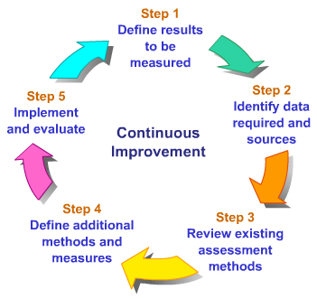
Continuous Improvement

Slide 27
Tell me and I forget. Teach me and I remember. Involve me and I learn. Benjamin Franklin

